Slide 1

Structure

Slide 2
Why we need structure?
Structure is a user-defined datatype in C language which allows us to combine data of different types together.
Structure helps to construct a complex data type which is more meaningful.
It is somewhat similar to an Array, but an array holds data of similar type only. But structure on the other hand, can store data of any type, which is practical more useful.

Slide 3
Array vs Structure
For example: If I have to write a program to store Student information, which will have Student's name, age, branch, permanent address, father's name etc, which included string values, integer values etc, how can I use arrays for this problem, I will require something which can hold data of different types together.

Slide 4
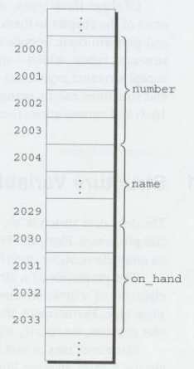
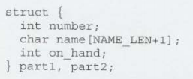
Declaring Structure Variables

Slide 5
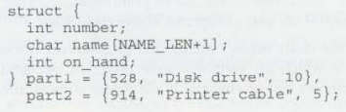
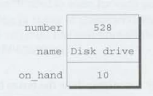
Initializing Structure Variables

Slide 6
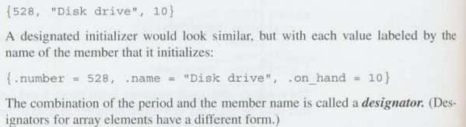
Designated Initializer

Slide 7
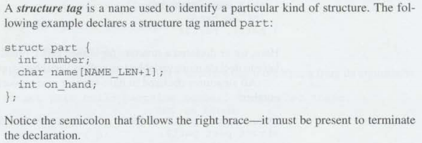
Declaring a Structure tag

Slide 8

Operations on Structure
All most all kinds of operations can be performed on structure
Print
Scan
Assignment
Mathematical
Array of Structure
Pointer
Pass as function arguments
And others

Slide 9
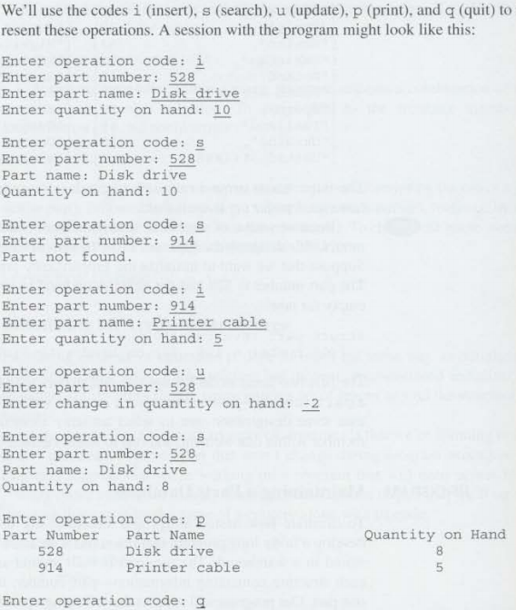
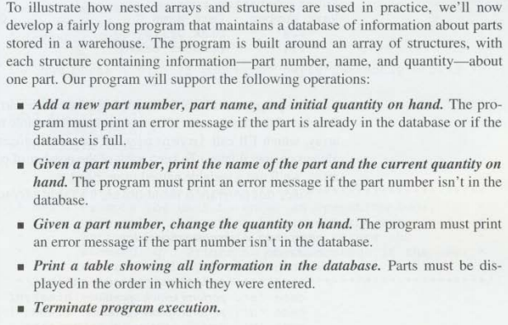
Problem Set

Slide 10

The End

